Slide 1


Generative AI and AIoT (GenAIoT) Coding Skills Education for Gifted Students (2024) Lesson 1.1: Getting Familiar with the Coding Environment

Slide 2
Table of Contents
Course logistics
Where are we?
Review of Computer and Programming
Fundamentals of Python Programming
Introduction
Python on Cloud vs on Local Machine
Anaconda and its installation
Jupyter Notebook
Introduction to Google Colab
Where to get support?

Slide 3
Acknowledgement
The Generative AI and AIoT (GenAIoT) Coding Skills Education for Gifted Students programme is fully funded by the Gifted Education Fund of the Education Bureau of The Government of Hong Kong Special Administrative Region.
We acknowledge the support from the Education Bureau, our programme would not be successful without their support.
3

Slide 4
Course Website
Course website:
https://cityueegef.github.io/
Our lessons schedule and video recordings will be uploaded to the course website
The video recordings are password encrypted
Please refer to our previous email for the password
All the learning materials are restricted for our students’ use only, no re-selling is allowed!
4

Slide 5
Lecture Slides Naming Convention
All our lecture slides are named in the following format:
- P{phase no.}L{lesson no.}.{pdf no.}_{title}
i.e. P2L1.1_Getting Familiar with the Coding Environment
The filename above indicates that this pdf file is the 1st pdf file for the lesson 1 of phase 2, and the title is “Getting Familiar with the Coding Environment”.
5

Slide 6
Recommended Books
M R Kishore Kumar (2021) Learn Python: A Beginner's Guide to Python, Numpy, Pandas and Scipy
Francois Chollet (2021) Deep Learning with Python, 2nd Edition
Prateek Joshi (2017) Artificial Intelligence with Python
Joel Grus (2019) Data Science from Scratch: First Principles with Python
Geron Aurelien (2019) Hands-On Machine Learning with Scikit-Learn and TensorFlow
Alger Fraley (2023) The Artificial Intelligence and Generative AI Bible
6

Slide 7
Table of Contents
Course logistics
Where are we?
Review of Computer and Programming
Fundamentals of Python Programming
Introduction
Python on Cloud vs on Local Machine
Anaconda and its installation
Jupyter Notebook
Introduction to Google Colab
Where to get support?

Slide 8
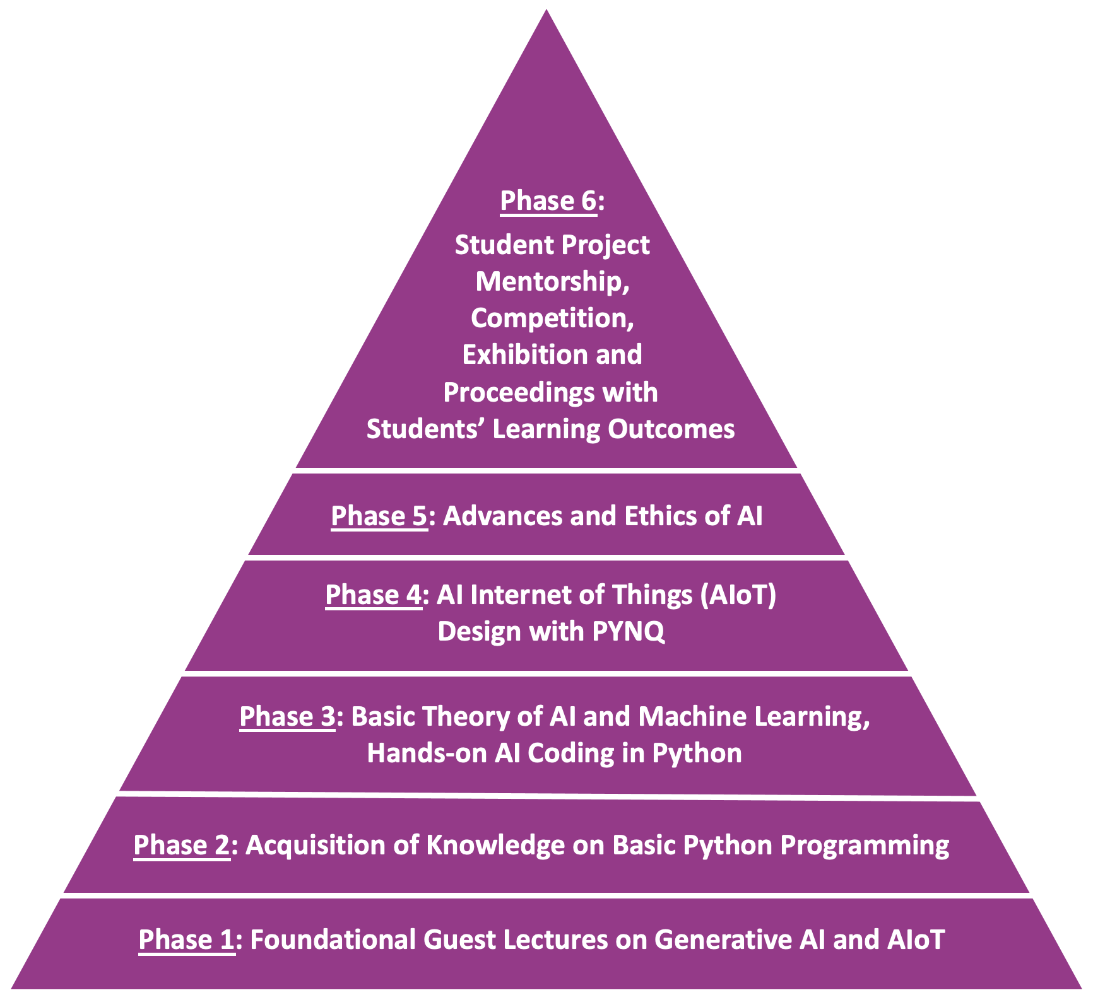
6 Phases of the Programme
To get to the top of this pyramid, we need to build a strong foundation first!
Phase 1+2:
Foundational Guest Lectures: GenAI, AIoT, Acquisition of Knowledge on Basic Python Programming
8

Slide 9
Table of Contents
Course logistics
Where are we?
Review of Computer and Programming
Fundamentals of Python Programming
Introduction
Python on Cloud vs on Local Machine
Anaconda and its installation
Jupyter Notebook
Introduction to Google Colab
Where to get support?

Slide 10
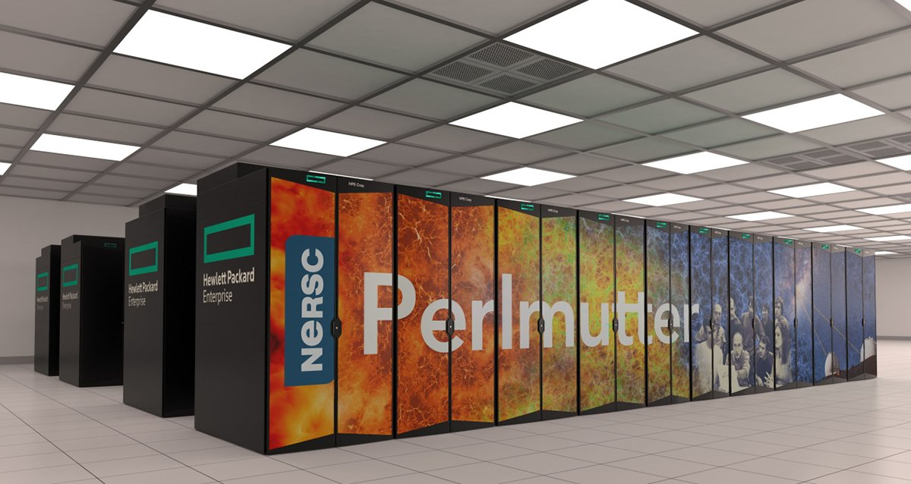
Review of Computer and Programming
Here, we review the following
What is a computer?
Various peripherals of a computer and their usages
Machine/Assembly/high-level languages
Compiler and interpreter
Algorithms and flow-chart

Slide 11
Table of Contents
Course logistics
Where are we?
Review of Computer and Programming
Fundamentals of Python Programming
Introduction
Python on Cloud vs on Local Machine
Anaconda and its installation
Jupyter Notebook
Introduction to Google Colab
Where to get support?

Slide 12
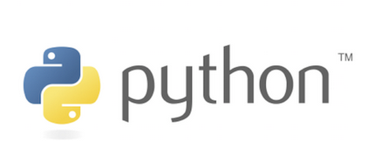

Introduction to Python Programming
Python is a high-level, interpreted language
It is simple, readable, interactive, object-oriented, versatile, and user-friendly
Variables don’t need to be explicitly declared.
First released in 1991 by Guido Van Rossum
Now commonly used for AI applications
Python was named after the BBC TV show,
“Monty Python’s Flying Circus.”
12

Slide 13
Why is Python popular, although slow?
Second most-used programming language on GitHub in 2022.
It has high productivity.
Suitable for a variety of tasks and applications
Its speed is enough for many applications.
simplicity, readability, and versatility
Very suitable for task automation, web development, and data analysis
Open-source, portable, and huge community and library supports.
Python:
print("Hello world.")
Java:
public class HelloWorld {
public static void main (String[]args) {
System.out.println.("Hello world");
}
}
13

Slide 14
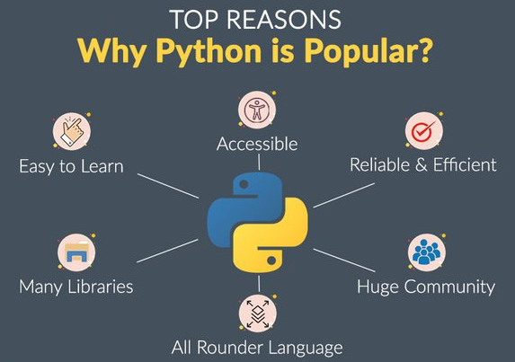
Why is Python popular, although slow?
14

Slide 15
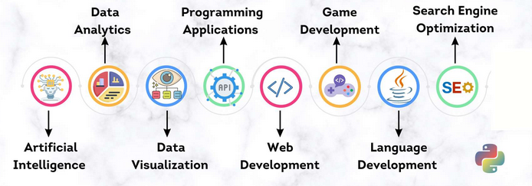
What is Python good for ?
15
https://github.blog/2023-03-02-why-python-keeps-growing-explained/

Slide 16
How to get started?
30-Days-Of-Python, PyFlo, Python Wiki
W3Schools, Python official tutorial, Khan Academy, and other online tutorials
Pre-built algorithms, and code samples
Explore cheatsheet
Udemy, Coursera, and other online courses
Books
Essential Python for Machine Learning
Learn to Code by Solving Problems: A Python Programming Primer
Learning IoT with Python and Raspberry Pi
What You Need to Know about Machine Learning
16

Slide 17

Python IDEs and Tools
Native Python interpreter.
Online Python tools e.g., Google Colab
Python IDEs
PyCharm
Visual Studio Code (VSCode)
Mu Editor, Thonny
Spyder, Komodo IDE
Eclipse with PyDev
IDLE, NetBeans
Jupiter notebook
Is a Python distribution that comes with all the necessary Python and R tools for AI and other scientific computing.
17

Slide 18
Table of Contents
Course logistics
Where are we?
Review of Computer and Programming
Fundamentals of Python Programming
Introduction
Python on Cloud vs on Local Machine
Anaconda and its installation
Jupyter Notebook
Introduction to Google Colab
Where to get support?

Slide 19


Python on Cloud vs on Local Machine
Python can be run on a cloud server or on a local machine
Cloud server (Google Colab)
No Python installation required
Free AI accelerators (GPU, TPU)
Computer accessories (camera, mic, etc) not available
(For free version) Disconnect automatically when not in use
Local machine
Computer accessories (camera, mic, etc) available
Won’t disconnect automatically
Python installation required
No free AI accelerators
19

Slide 20
Table of Contents
Course logistics
Where are we?
Review of Computer and Programming
Fundamentals of Python Programming
Introduction
Python on Cloud vs on Local Machine
Anaconda and its installation
Jupyter Notebook
Introduction to Google Colab
Where to get support?

Slide 21


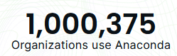
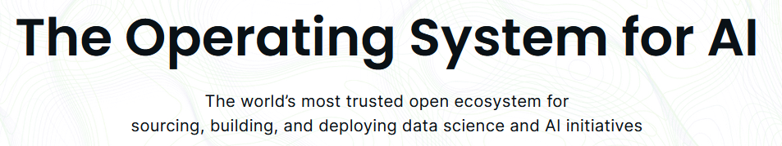
Distribution of Python and R packages for AI and other scientific computing.
Open-source package and environment manager
Over 1000 data packages
250 popular data science packages.
21

Slide 22
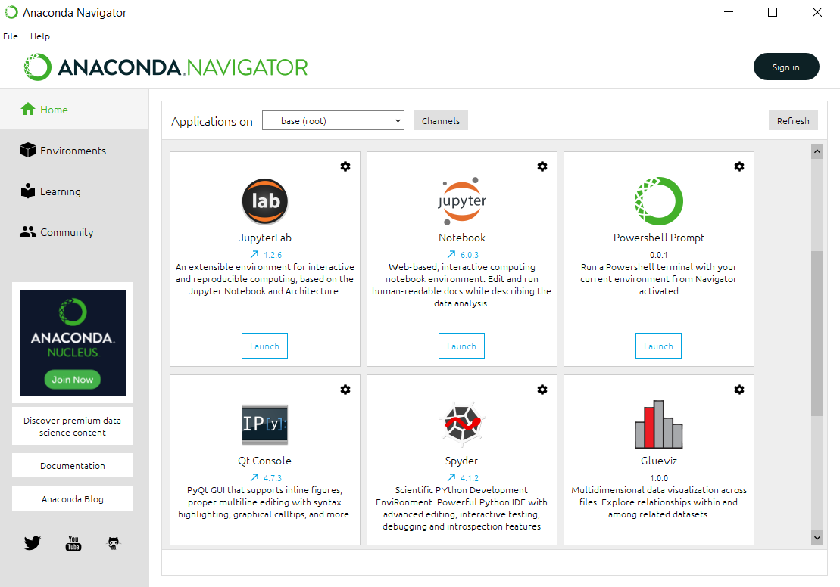
Anaconda
Some of the useful Integrated Development Environments (IDEs) are pre-installed:
Jupyter Notebook
Jupyter Lab
Spyder
22

Slide 23
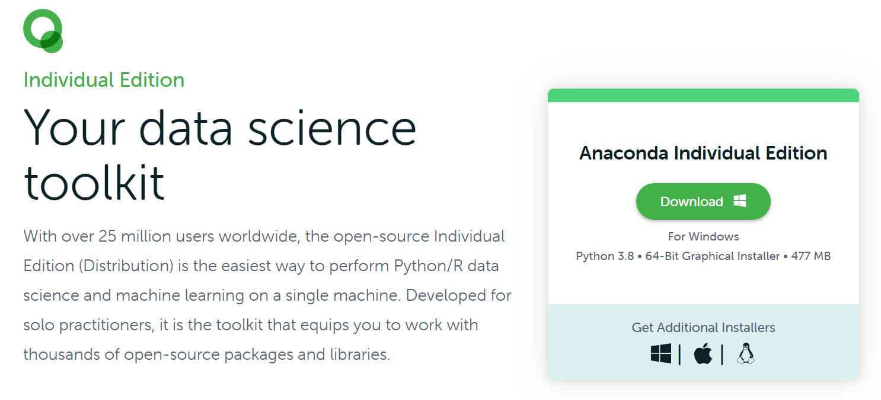
Installing Anaconda
Go to: https://www.anaconda.com/products/individual
Download the latest version of Anaconda installer for your OS
23

Slide 24
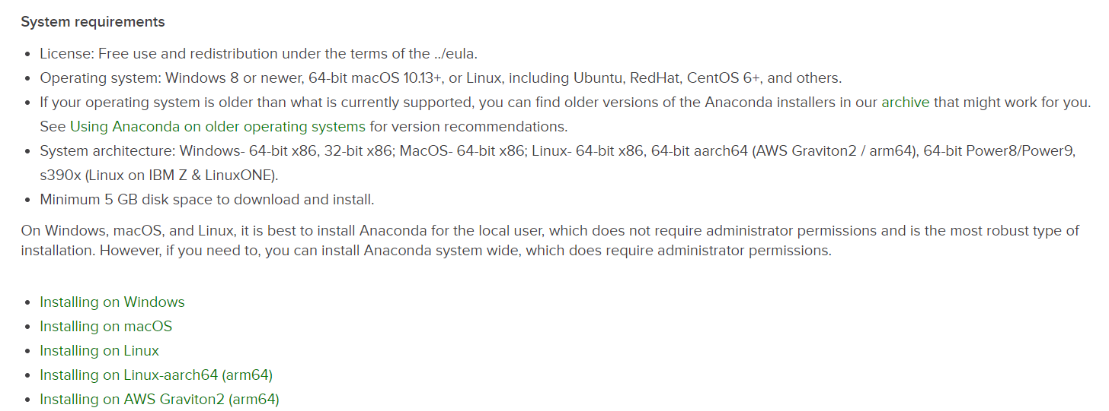
Installing Anaconda
After downloading, go to: https://docs.anaconda.com/anaconda/install/
Choose your OS and follow the instructions to install Anaconda
Note: make sure your computer can fulfil the system requirements, i.e.: having at least 5GB disk space
24

Slide 25
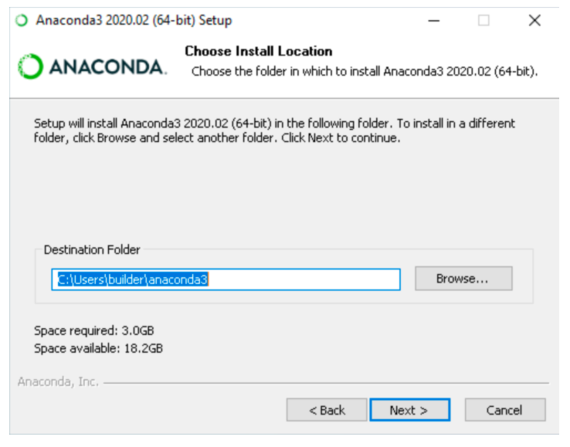
Installing Anaconda
Run the installer
Agree the licensing terms
[For Windows] Select an install for “Just Me” option
Select a destination folder
25

Slide 26
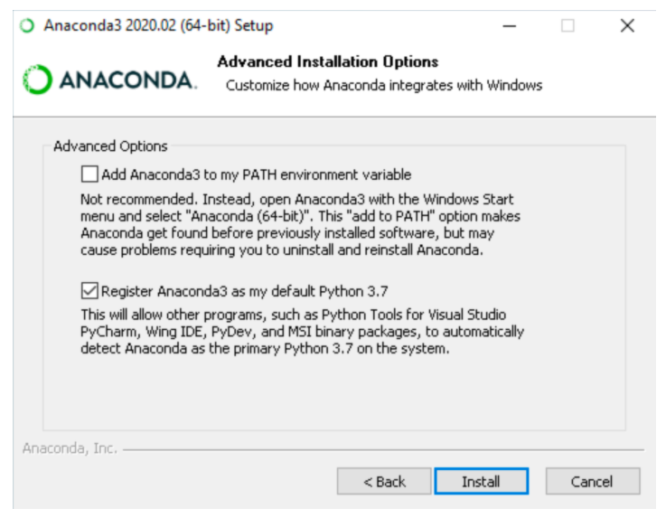
Installing Anaconda
For Windows, uncheck the “Add Anaconda3 to my PATH environment variable” option
Check the “Register Anaconda3 as my default Python 3.x” option (Recommended)
Click “Install”
26

Slide 27
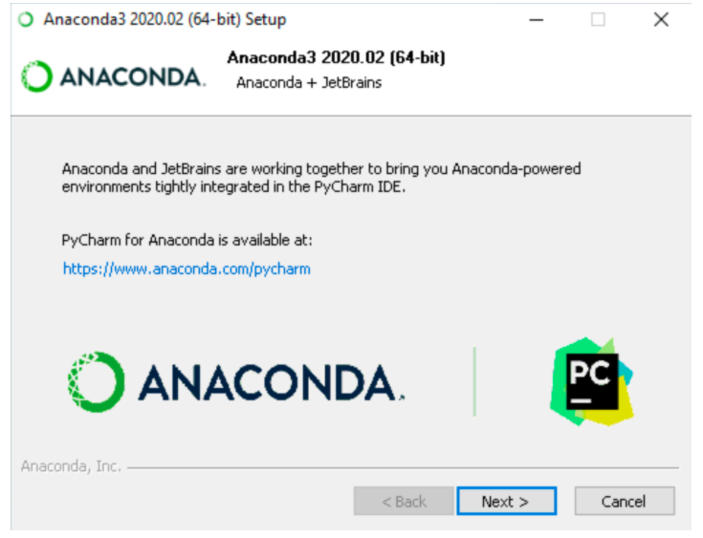
Installing Anaconda
Click “Next >”(Win)/”Continue”(Mac) when you are asked to install PyCharm
PyCharm is not needed for our course
27

Slide 28
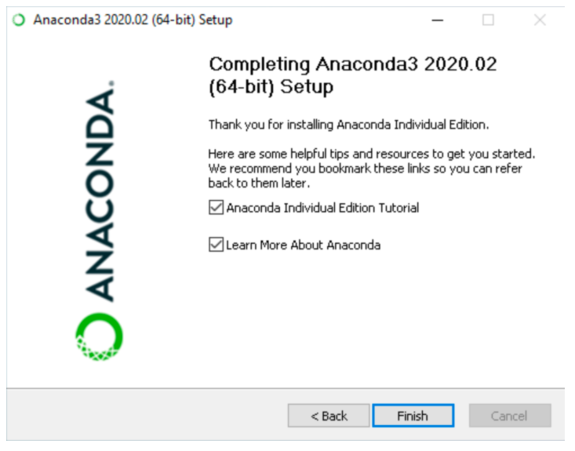
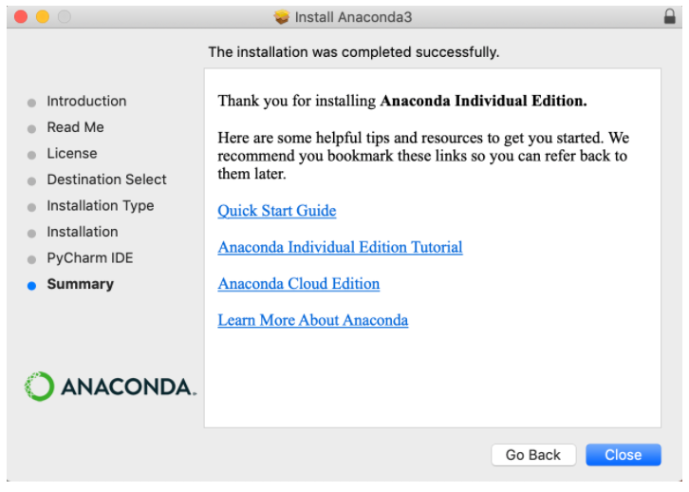
Installing Anaconda
You will see “Thanks for installing Anaconda” after successful installation
28

Slide 29
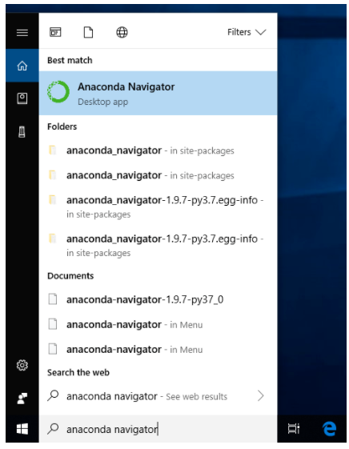
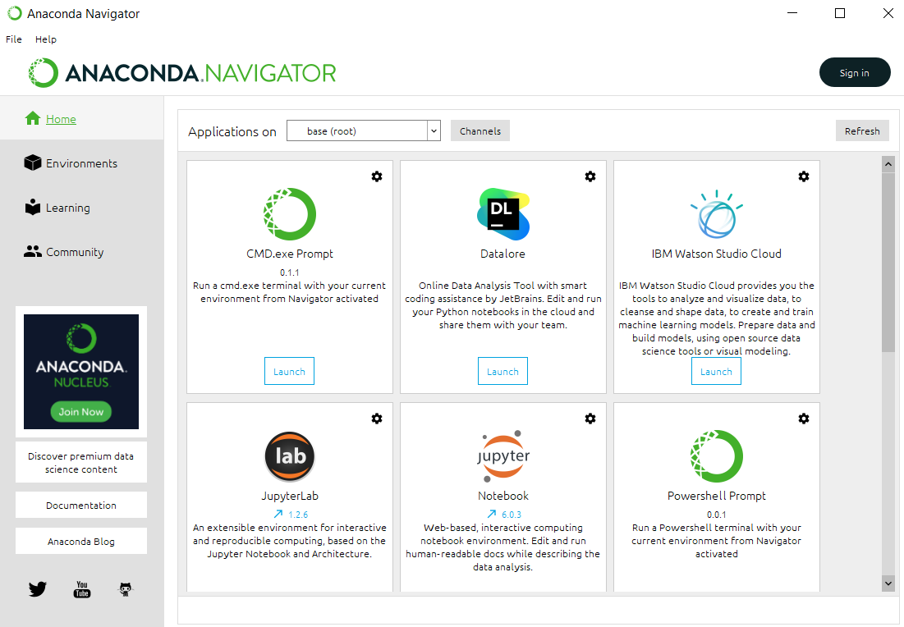
Verifying Installation
Launching Anaconda Navigator (Graphical User Interface)
Windows: Click Start, search or select Anaconda Navigator from the menu.
Mac: Click Launchpad, select Anaconda Navigator.
Linux: Use terminal to launch Anaconda Navigator (see next page)
29

Slide 30
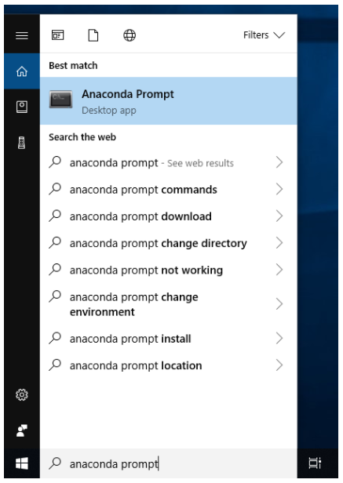
Verifying Installation
Launching conda (Command Line Interface)
You can use conda to verify the installation using Anaconda Prompt (Windows) or terminal (Linux/Mac):
Windows: Click Start, search, or select Anaconda Prompt from the menu.
Mac: Cmd+Space to open Spotlight Search and type “Navigator” to open the program.
Linux–CentOS: Open Applications - System Tools - terminal.
Linux–Ubuntu: Open the Dash by clicking the upper left Ubuntu icon, then type “terminal”.
30

Slide 31
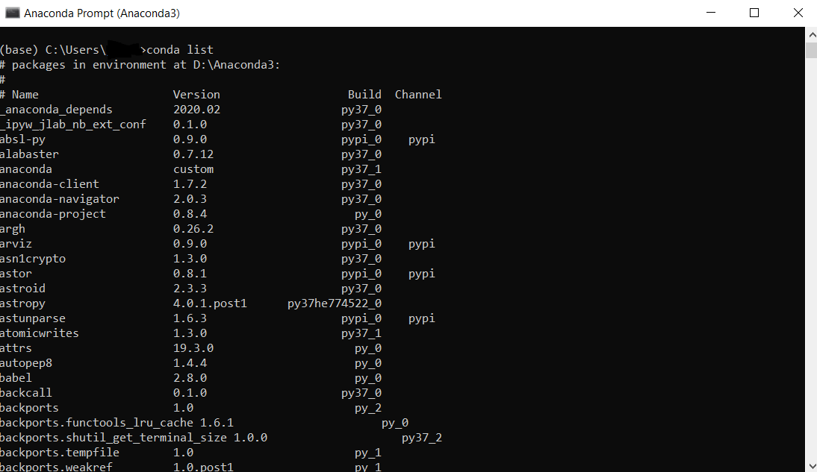
Verifying Installation
After opening Anaconda Prompt or the terminal, choose any of the following methods to verify:
Enter conda list. If Anaconda is installed and working, this will display a list of installed packages and their versions.
Enter the command python. This command runs the Python shell. If Anaconda is installed and working, the version information it displays when it starts up will include “Anaconda”. To exit the Python shell, enter the command quit().
Open Anaconda Navigator with the command anaconda-navigator. If Anaconda is installed properly, Anaconda Navigator will open.
31

Slide 32
Frequently Asked Questions
Q: I don’t have 5GB disk space, what should I do?
A: You may install Miniconda instead (https://docs.conda.io/en/latest/miniconda.html), but you may need to install some of the useful packages/IDEs, such as NumPy, Pandas, Jupyter Notebook etc, individually. For the difference between Anaconda and Miniconda, please see: https://stackoverflow.com/questions/45421163/anaconda-vs-miniconda
Q: I already have Python (but not Anaconda) installed, do I still need to install Anaconda?
A: The option is up to you, but we recommend Anaconda as it is a convenient tool for beginners, it ships with a lot of useful Python packages, and a package and environment management system called Conda. Our course tutors maybe unable to provide additional supports to you if you choose not to install Anaconda.
32

Slide 33
Frequently Asked Questions
Q: Can I not install Python/Anaconda yet being able to complete this course successfully?
A: For most of the exercises for our course, you can complete them on the cloud computing platform Google Colab (will be introduced next) without any installations on your local machine except a web browser. However, during the later phases of this course, you will be working on your own AI projects and you may want to run your Python program on your local machine.
For other FAQs about Anaconda, please visit:
https://docs.anaconda.com/anaconda/user-guide/faq/
33

Slide 34
Table of Contents
Course logistics
Where are we?
Review of Computer and Programming
Fundamentals of Python Programming
Introduction
Python on Cloud vs on Local Machine
Anaconda and its installation
Jupyter Notebook
Introduction to Google Colab
Where to get support?

Slide 35
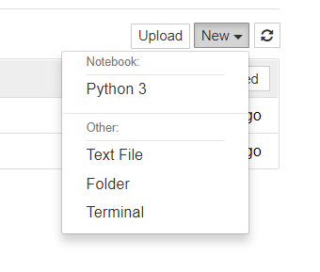
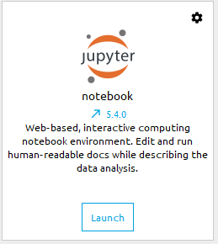
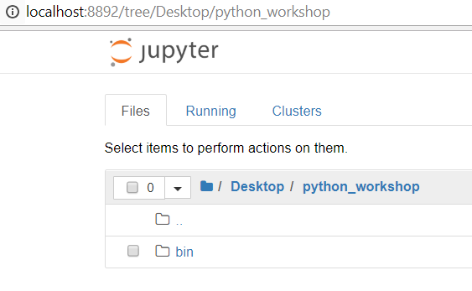
Jupyter Notebook
Jupyter Notebook (formerly known as iPython notebook) is a browser-based, interactive computing notebook environment for Python, R, Julia, etc
You can edit and run human-readable docs while describing the data analysis (Good for presenting your work!)
3. Create a new Python 3 Notebook
1. Launch Jupyter Notebook
2. Navigate to the folder where you want to save your notebook
35

Slide 36
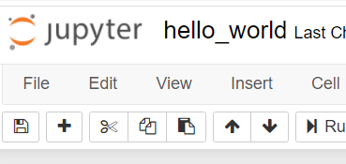
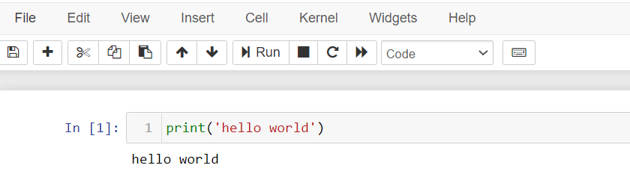
Jupyter Notebook – Code Cell
A code cell is for writing codes that will be executed
Print statement
Line of code that will output data to the console
i.e. print(‘hello word’)
Click “Run” button or Shift+Enter
Tip: You can change your notebook name at the top left corner here
1. Select “Code”
2. Click “+” to create a code cell
4. Click “Run”
Note:
We are using Python 3 not Python 2!
The syntax in Python 2 is different! (no bracket for the print function)
36
3. Type your code

Slide 37
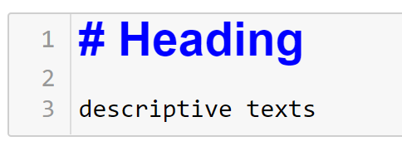

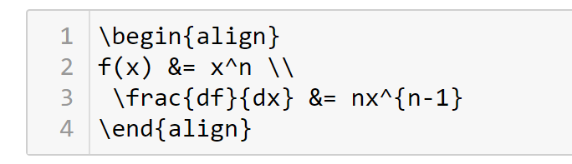

Jupyter Notebook – Markdown
A markdown/text cell is for writing descriptive texts which describe the codes
Prefix the text with “#” and an empty space to make it a markdown heading
Math equations can be included using LaTeX codes
Shift + Enter
Shift + Enter
37

Slide 38
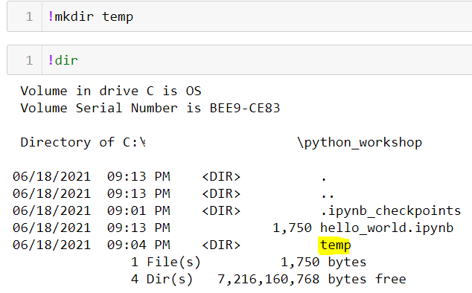
Shell Commands
Shell commands can be executed directly inside Jupyter Notebook by prefixing it with the “!” character (Note: shell commands are different for different OS, i.e. the command for list directories in Linux is ls, but it is dir in Windows)
For example, you can create a new folder using the !mkdir command:
38

Slide 39
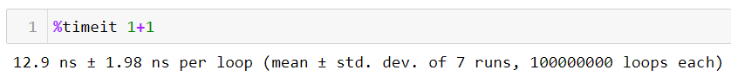
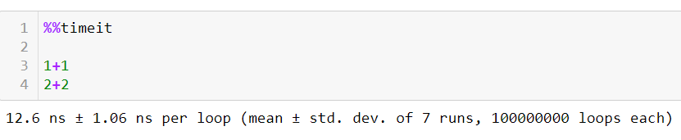
Magic Commands
Jupyter Notebook also provide a set of built-in commands called magic commands
Magic commands can be executed by prefixing with “%” (line magic) or “%%” (cell magic)
For example, to time a line of code:
To time a cell of codes:
39

Slide 40
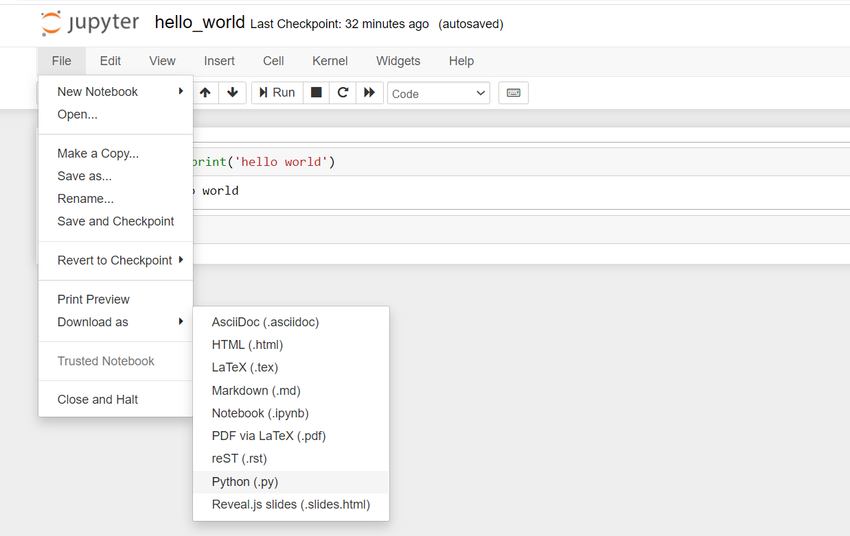
Running Python on Command Line
Open a Jupyter notebook or any text editors/IDEs you like
Save your hello world program as “hello_world.py” (Notice the .py extension)
Click “File -> Download as -> Python (.py)”
40

Slide 41
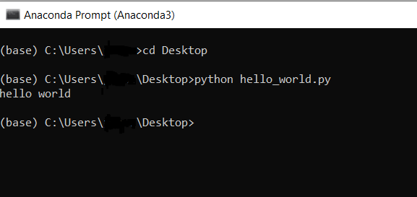
Running Python on Command Line
Open the Anaconda Prompt/Terminal
Go to the folder where you saved the hello_world.py file by typing the command “cd /path/to/folder/” and press enter
Type “python hello_world.py” and press enter to run the program
41

Slide 42
Jupyter in VSCode (Optional)
42

Slide 43
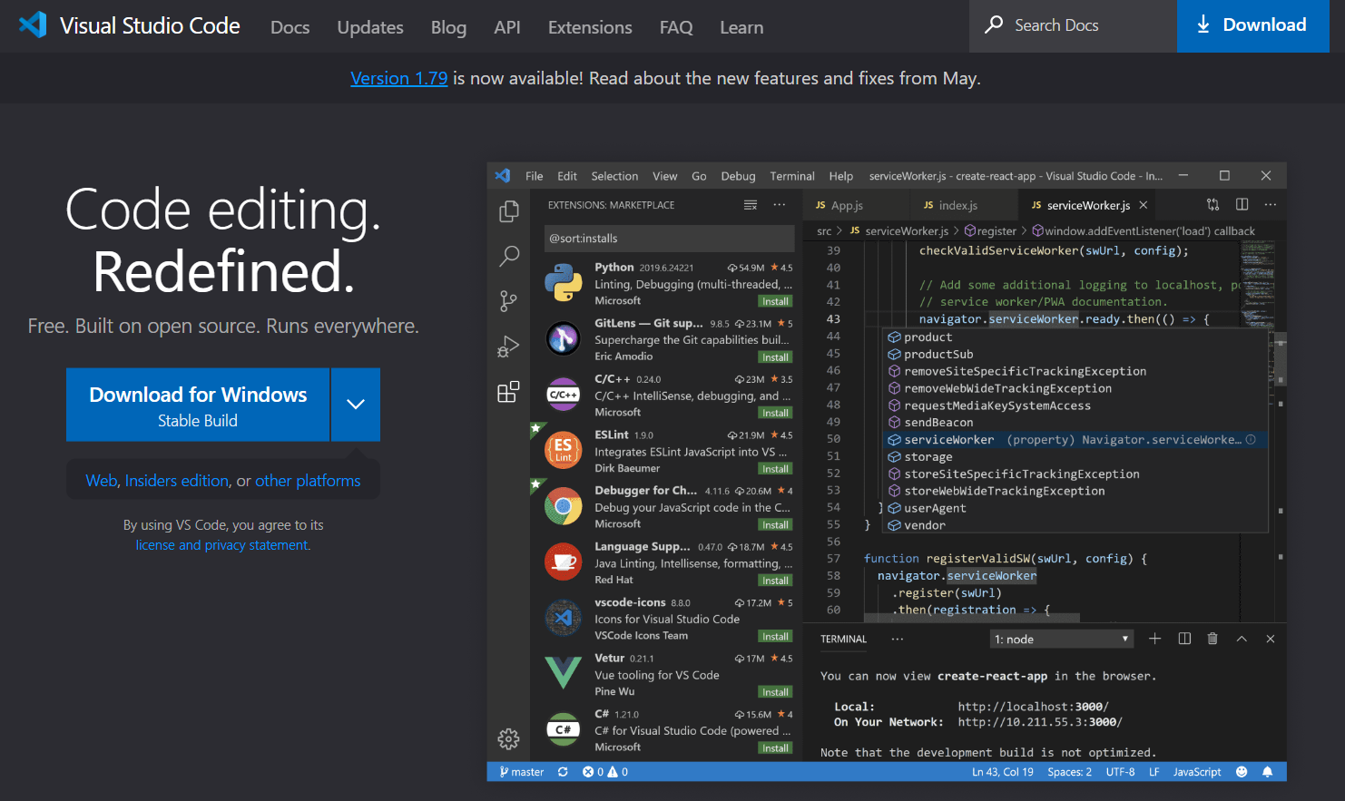
Install Microsoft Visual Studio Code
Download Visual Studio Code:
https://code.visualstudio.com/
43

Slide 44
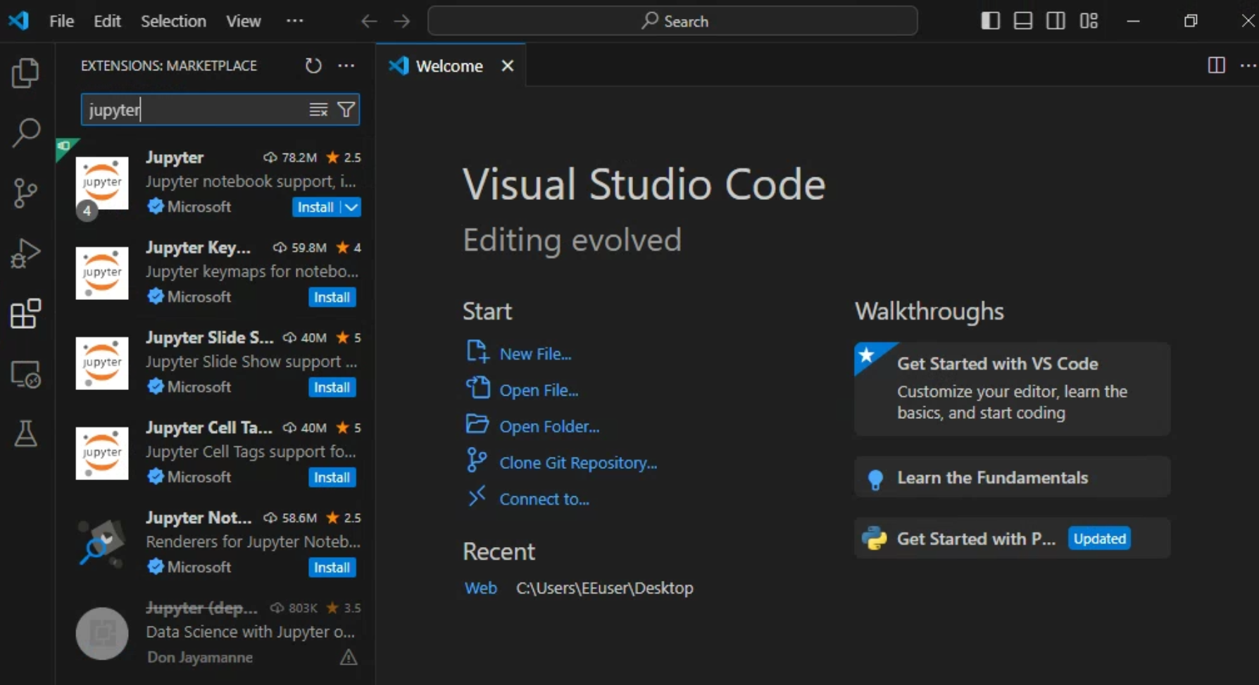
Install Jupyter Extension for VSCode
Click the Extension icon (Ctrl + Shift + x)
Search for the “Jupyter” Extension and install it
44

Slide 45
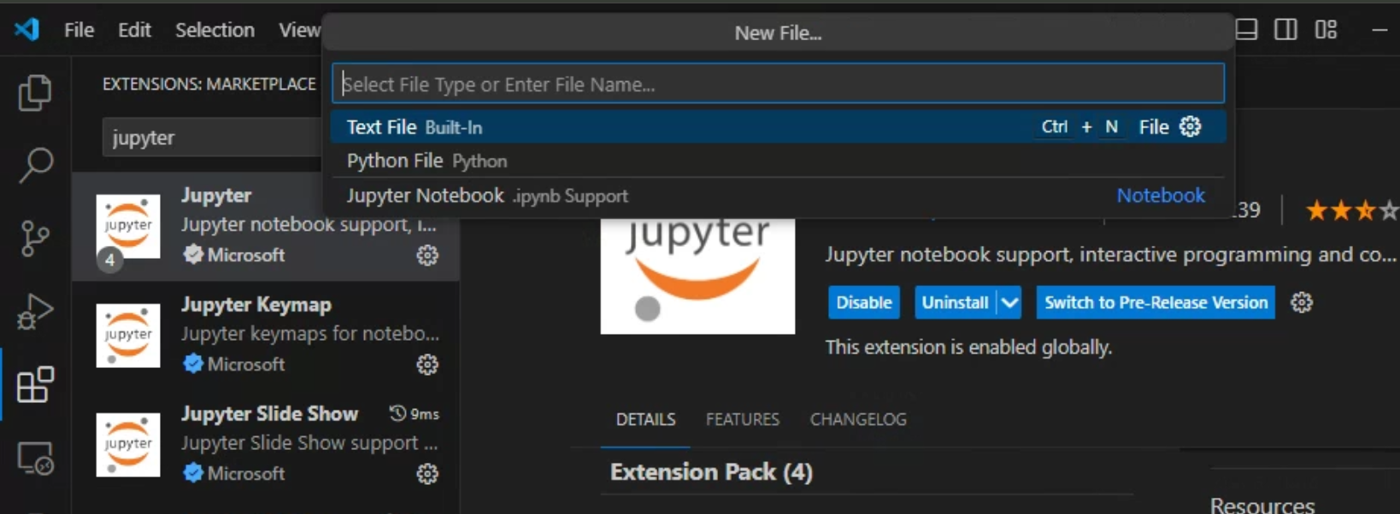
Creating a Jupyter Notebook
To create a notebook, click: “File” -> “New File…” and choose “Jupyter Notebook”
45

Slide 46
Table of Contents
Course logistics
Where are we?
Review of Computer and Programming
Fundamentals of Python Programming
Introduction
Python on Cloud vs on Local Machine
Anaconda and its installation
Jupyter Notebook
Introduction to Google Colab
Where to get support?

Slide 47
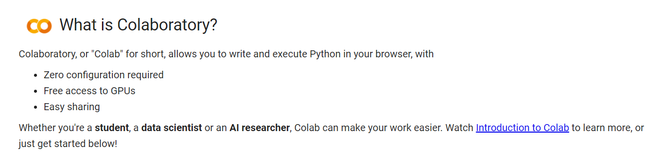
Introduction to Google Colab
Jupyter Notebook on the Google Drive
Can be connected to a Ubuntu Linux runtime provided by Google
Can execute Python codes without any installations on local machine
Python packages for AI pre-installed, i.e. NumPy, Scikit Learn, TensorFlow, etc
Provide hardware accelerator for AI for free!
Welcome To Colaboratory Notebook:
https://colab.research.google.com/notebooks/intro.ipynb?utm_source=scs-index#
47

Slide 48
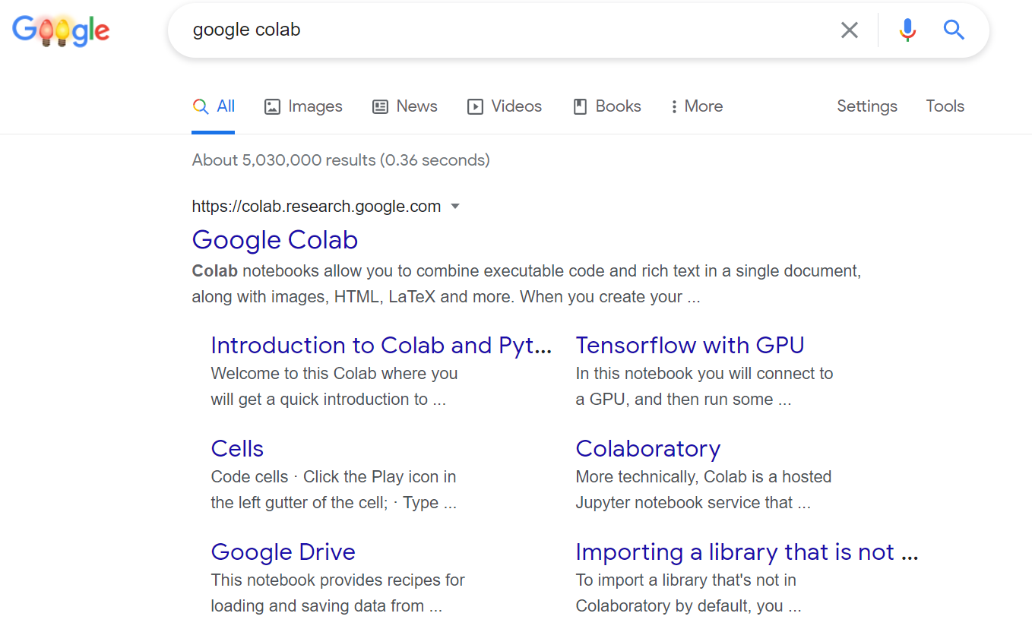
Searching “google colab” on Google
Click “Google Colab”
Make sure you have logged in your Google account first!!!
48

Slide 49
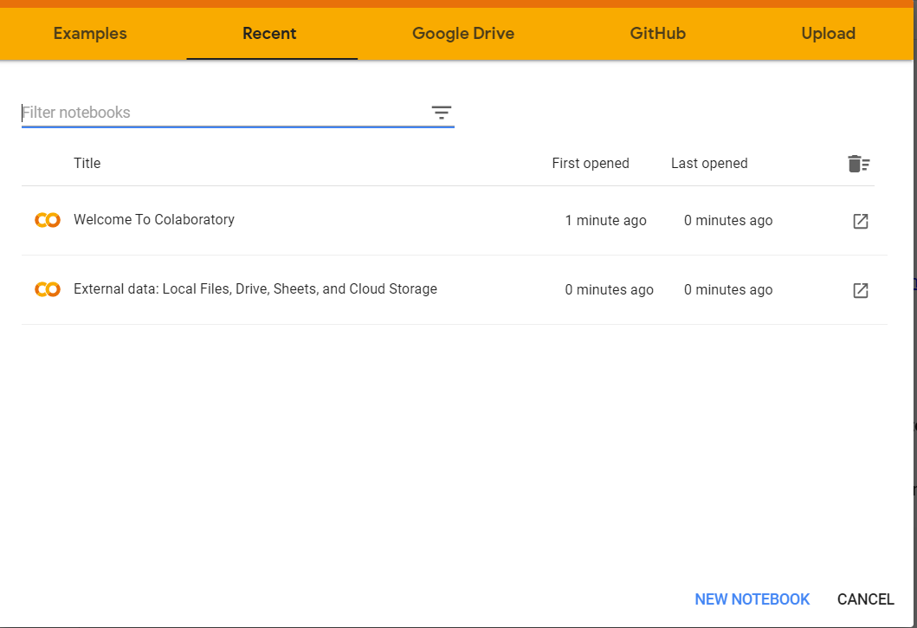
Creating a New Notebook
Click “NEW NOTEBOOK”
49

Slide 50
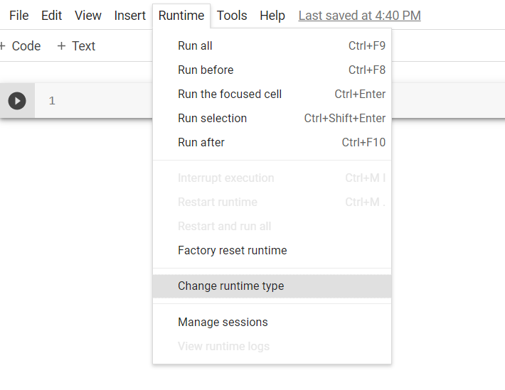
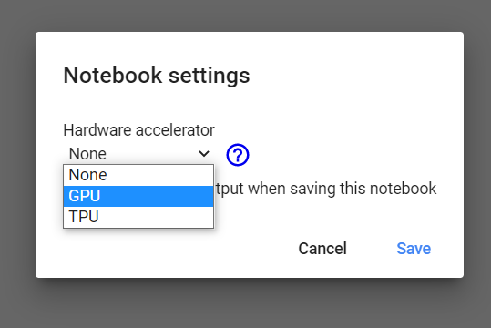
Changing Runtime Type
Colab provides Graphical Processing Unit (GPU) and Tensor Processing Unit (TPU) to accelerate AI computations for free!
50

Slide 51
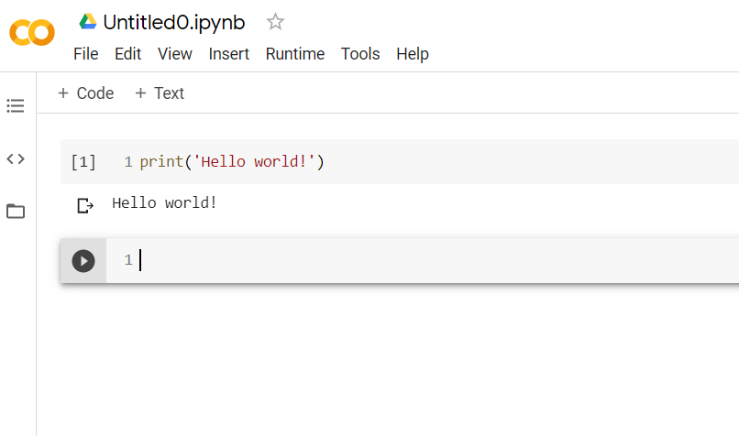
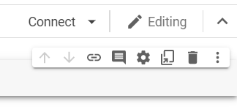
Connecting to a Runtime
1. Click “Connect” to connect your notebook to a runtime
2. Try to print “Hello world!”, run the cell by pressing “Shift”+”Enter”
51

Slide 52
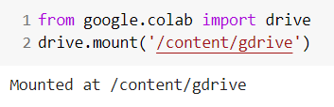
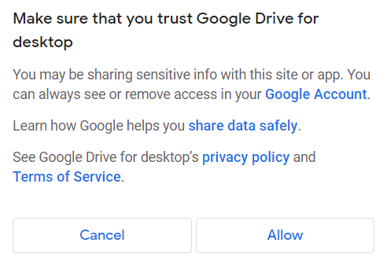
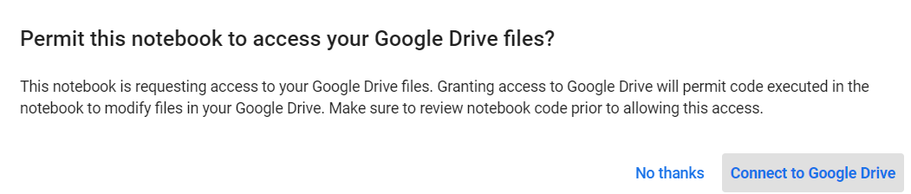
Connecting Colab to Your Google Drive
1
Type and run the code as shown on the left
Click “Connect to Google Drive”
Choose your google account and click “Allow”
You will see “Mounted at /content/gdrive” if successful
The path “/content/gdrive/MyDrive” contains your Google Drive files
2
3
52

Slide 53
Table of Contents
Course logistics
Where are we?
Review of Computer and Programming
Fundamentals of Python Programming
Introduction
Python on Cloud vs on Local Machine
Anaconda and its installation
Jupyter Notebook
Introduction to Google Colab
Where to get support?

Slide 54
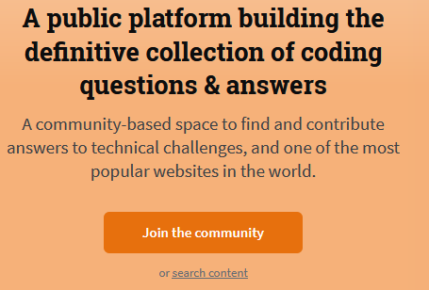
Where to get support?
Ask questions at Stack Overflow
Join the community and get started
https://stackoverflow.com/
Reddit (e.g., r/learnprogramming)
Official Websites, Wikis and Forums (
Search Google/YouTube
Use ChatGPT e.g. Perplexity
Documentations
Ask Instructors and TAs, Don’t feel shy !!!

Slide 55
Resources
Python FAQ and guide https://docs.python.org/3/faq/
Anaconda User Guide – Getting Started with Anaconda https://docs.anaconda.com/anaconda/user-guide/getting-started/
iPython documentation https://ipython.readthedocs.io/en/stable/interactive/tutorial.html
Overview of Colaboratory Features Notebook https://colab.research.google.com/notebooks/basic_features_overview.ipynb
Towards Data Science – 10 tricks for a better Google Colab experience https://towardsdatascience.com/10-tips-for-a-better-google-colab-experience-33f8fe721b82#34af
The Linux command line for beginners https://ubuntu.com/tutorials/command-line-for-beginners#1-overview
55

Slide 56

56

